Slide 1
Arduino Workshop
“The best thing about a boolean is even if you are wrong, you are only off by a bit.”

Slide 2







Meet the team!
Ashley
DePauw
Biochemister
Comp Sci
Grace
UNCC
Comp Sci
Dominic
Stanford
Electrical
Engineering
Morgan
Augustana College
Mathematics Biochemistry
Jon
Clemson University
Electrical Engineering
Michael
UCLA
Applied
Mathematics
Dobromir
Ramapo College
Mathematics and Comp Sci

Slide 3
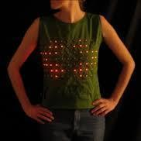
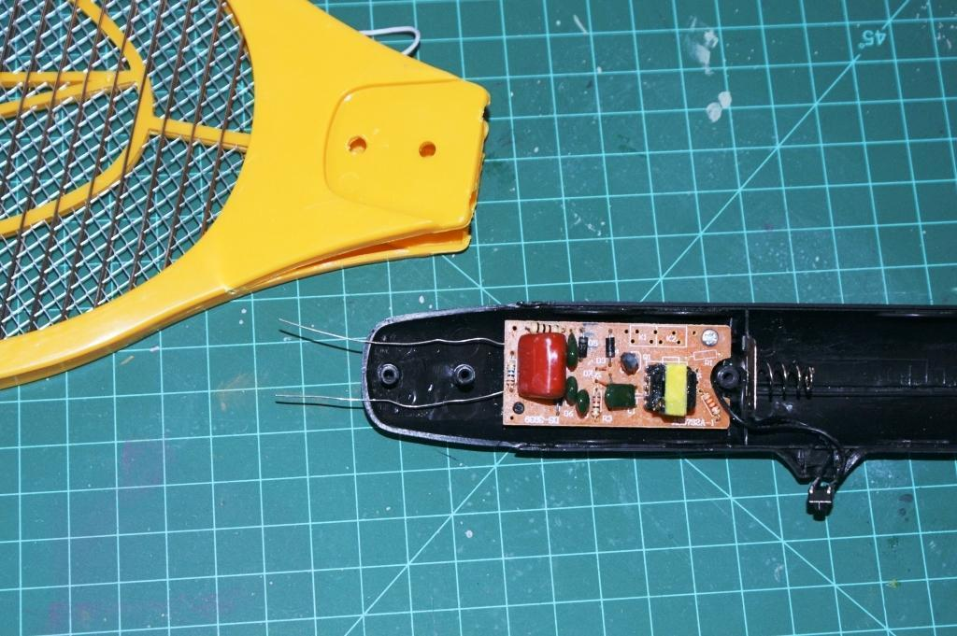
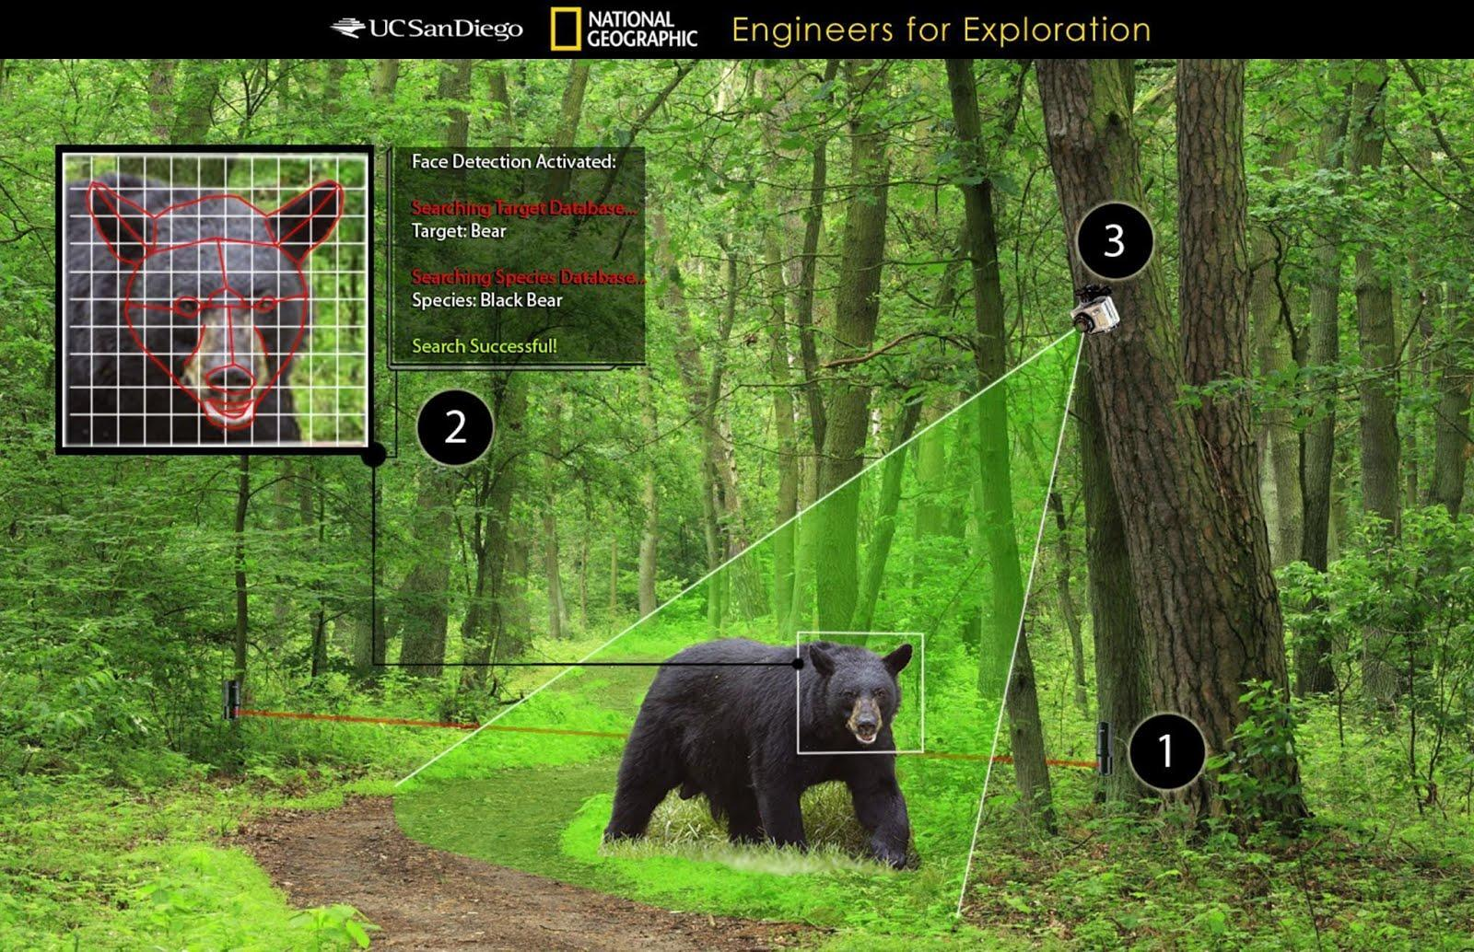
Cool Projects
Projects we have done:
  Barometer
  Gyroscope based mirror correction
  E-textiles
  Pitot tube
  Fountain audio-visualizer
  Arduino Cell Phone
  Industrial Applications
  Camera Trap
Notes:
everyone

Slide 4

Industrial Application

Slide 5
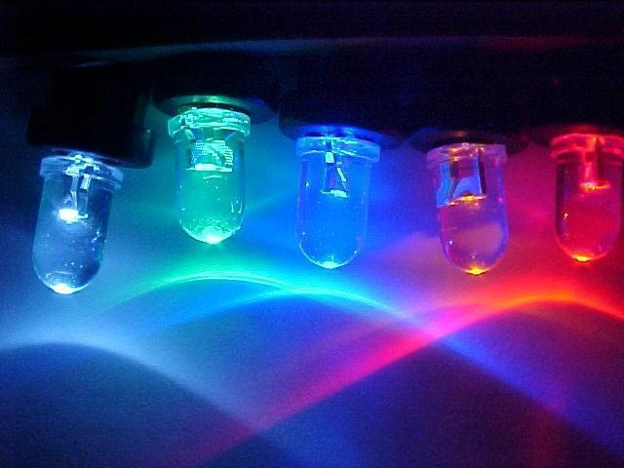
ECE 201
Breadboard: basis for electronic prototypes
  Easy to alter
  No need for soldering
Circuits:
foundation for
electronics
  Kirchhoff's Laws
  Can incorporate
  a variety of tools
Notes:
Morgan

Slide 6
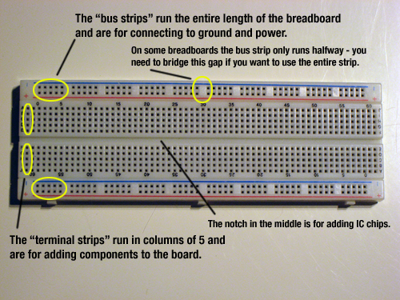
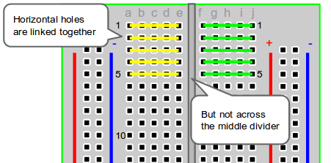
Breadboard
http://computers.tutsplus.com/tutorials/how-to-use-a-breadboard-and-build-a-led-circuit--mac-54746
http://tymkrs.tumblr.com/post/6386624174/how-to-use-a-breadboard

Slide 7
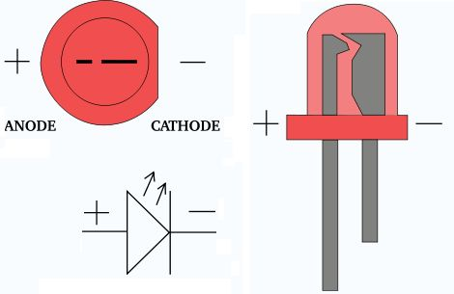
More LEDs
http://www.instructables.com/id/LED-Polarity-Tester/

Slide 8
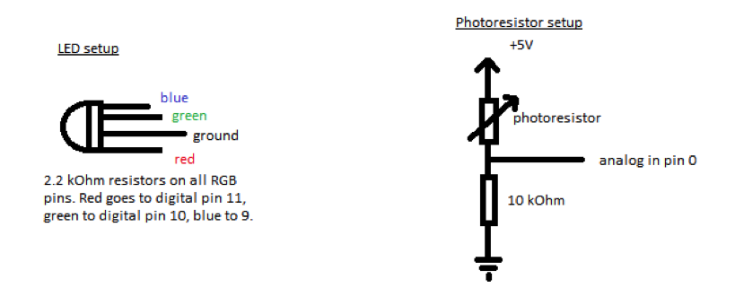
LEDs and Voltage Dividers

Slide 9
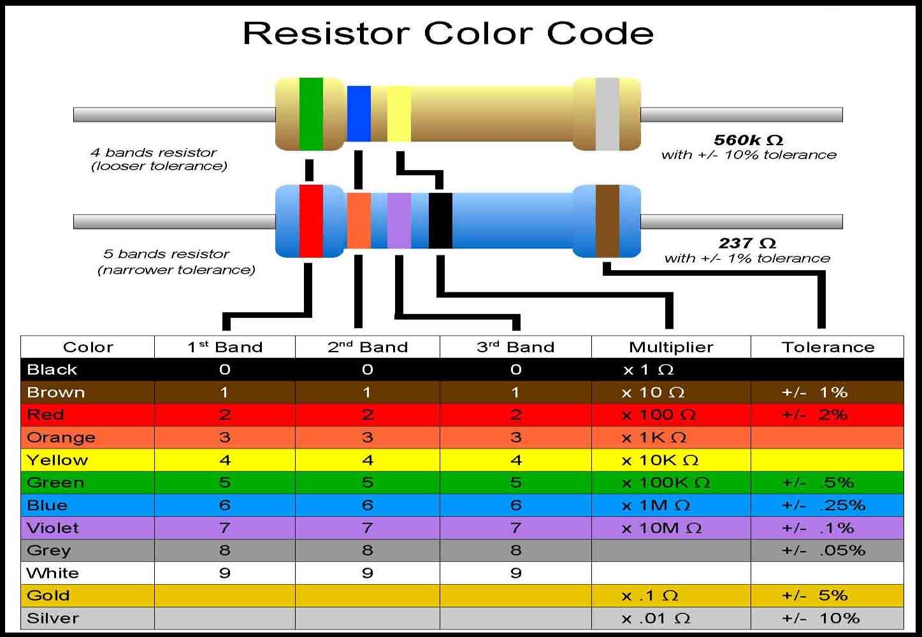
Resistors!
http://www.google.com/imgres?imgurl=&imgrefurl=http%3A%2F%2Fdiy-stem.org%2Fknatom%2Fresistors%2F&h=0&w=0&tbnid=VbUoXDea
7PenhM&zoom=1&tbnh=187&tbnw=270&docid=zo0TrBBZQS2NVM&tbm=isch&client=ubuntu&ei=KpXEU76BLu3hsASLzYHoBw&ved=0CAUQsCUoAQ

Slide 10

Arduino
Microcontroller
Open source physical computing platform
Inexpensive, cross-platform
Rapid prototyping

Slide 11
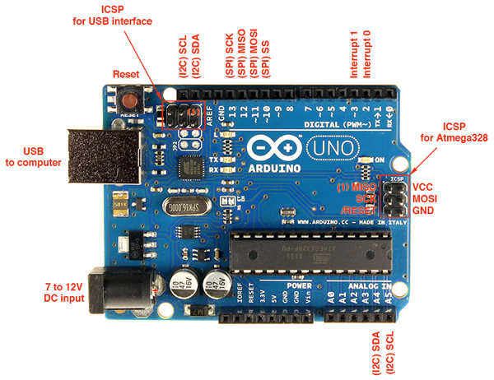
Arduino Components

Slide 12
Digital----------------Analog
1 → HIGH (> 3.3V)
0 → Low (< 3.3V)
Read and write voltages to pins
Read a voltage and get a value between decimal value
Output a PWM signal

Slide 13
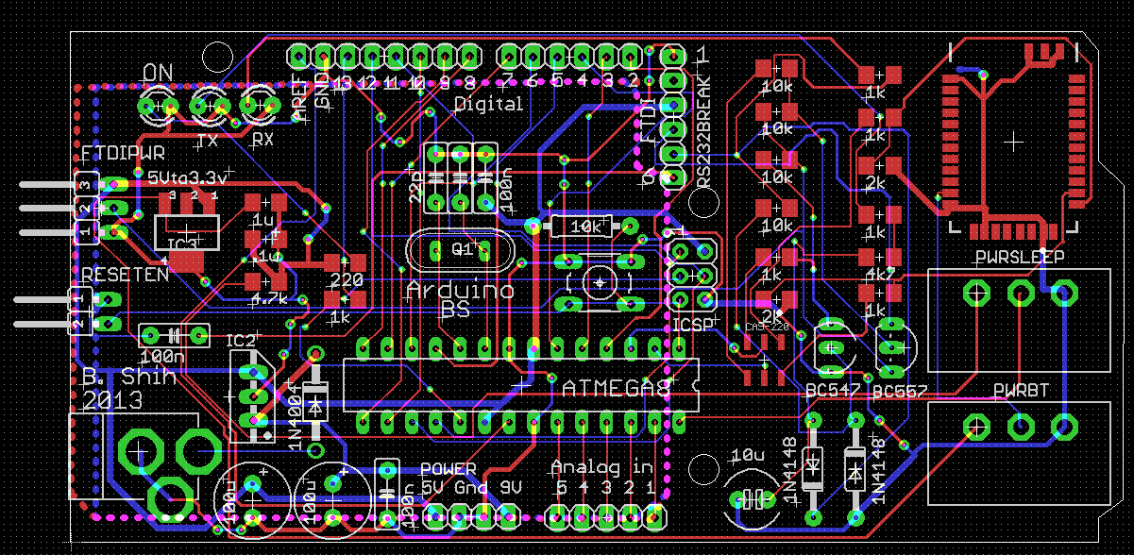
Arduino PCB

Slide 14
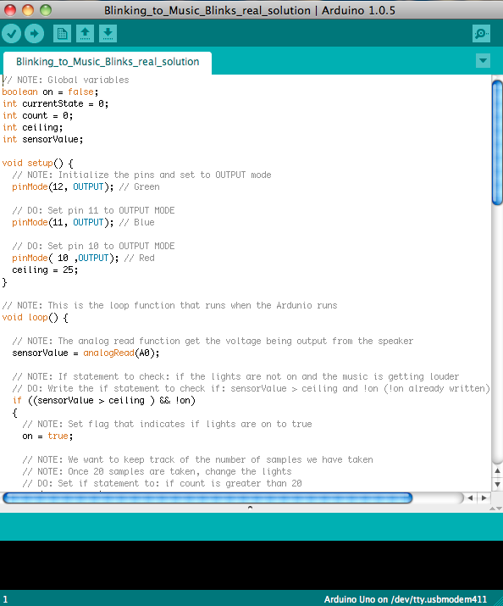
Code
Arduino IDE
Processor:
  Programmed with a C derivative.
What actually happens:
  Code gets compiled to machine code
  Syntax Errors get caught here
  Machine Code gets loaded onto the microcontroller
  Microcontroller executes code
Why is this so amazing?
Notes:
Juliana
Arduino IDE-All Arduino programming will be done in this development environment

Slide 15
Language Basics
Header:
  #include [statements]
// Comments these words are not compiled!
void setup(void) {} <-- must
void loop() {} <-- must
[type] functionName([type] var, [type] var2)
'{' and '}' indicate a "body" of code
  if, else, else if
  for
  switch
Notes:
Ashley

Slide 16
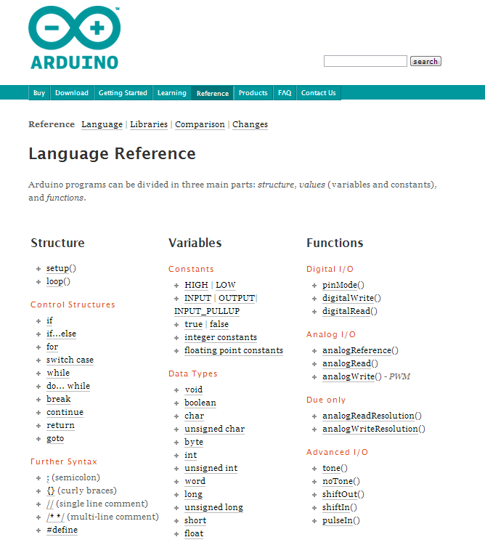
Online API
What is a library?
Why use a library?
What code is in the library?
Can I make my own library functions?
Where can I go for help coding?
http://arduino.cc/en/Reference/If
Notes:
Michael

Slide 17
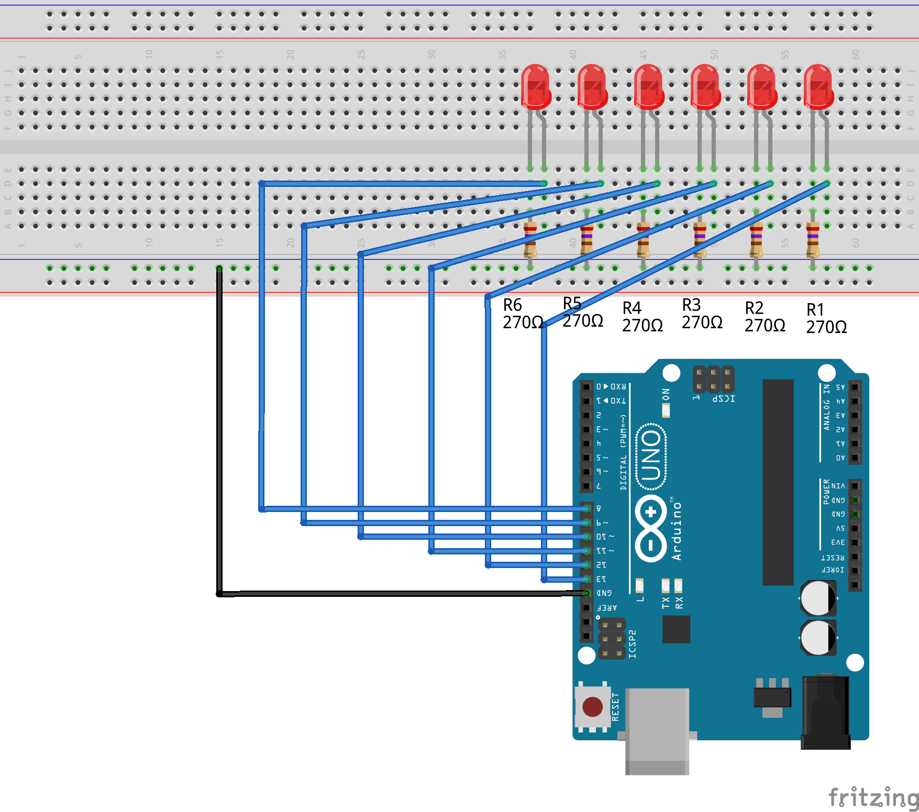
Die Circuit

Slide 18
Die Parts
6 - LEDs
6 - 270 Ohm Resistor

Slide 19
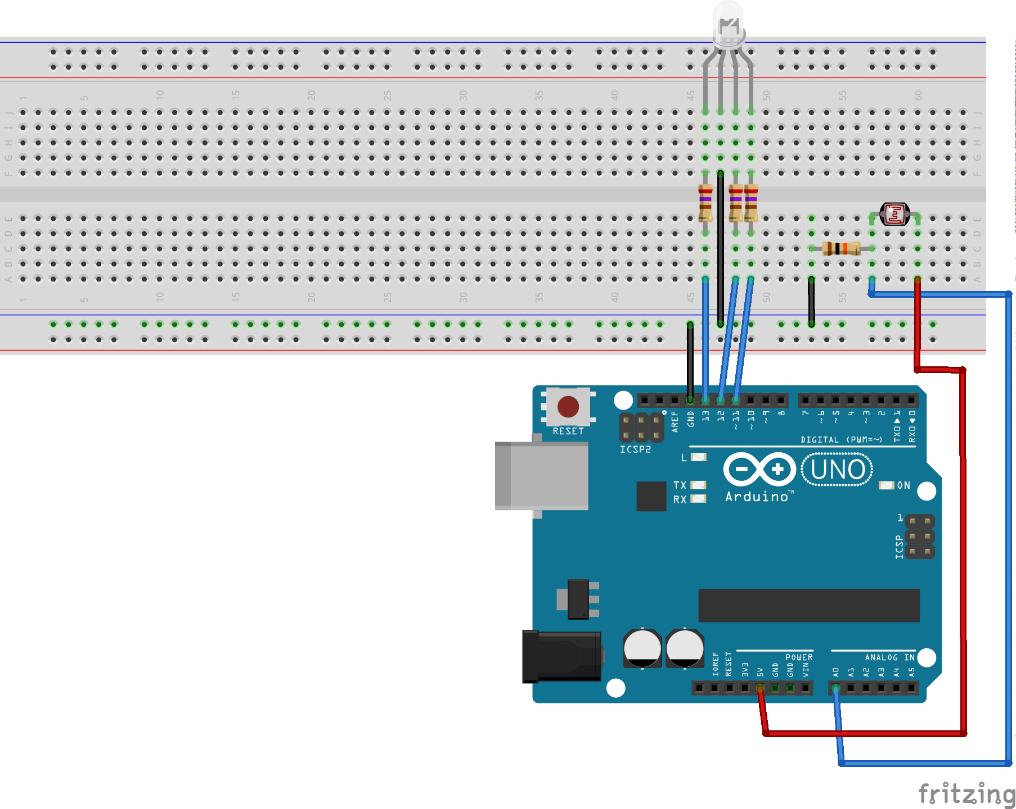
Distance Detection Circuit

Slide 20
Distance Detection Parts
3 - 270 Ohm resistor
1 – 10K Ohm resistor
1 – Photo-resistor

Slide 21
Party Lights Parts
1 – Speaker
1 – Audio Jack
3 – LEDs
3 – 270 Ohm resistors

Slide 22
Chat Parts
2 – Arduinos
3 – Wires

Slide 23
Meet the team!
Ashley
ashleymaeconard@gmail.com
Grace
gchriste@uncc.edu
Dominic
delgado4@stanford.edu
Morgan
mtsorensen13@ole.augie.edu
Jon
Oakl.jon@gmail.com
Michael
michaelputhawala@gmail.com
Dobromir
dyordan@google.com

Slide 24
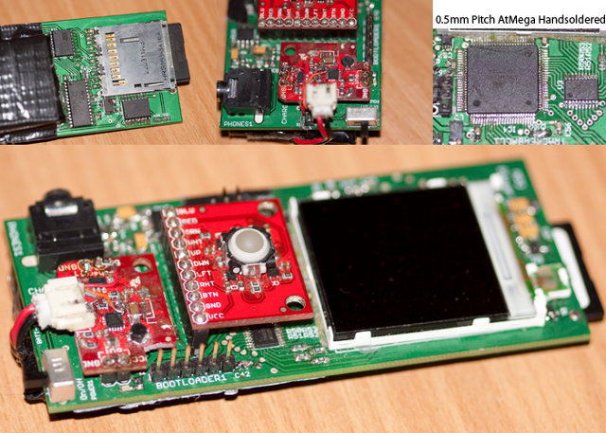
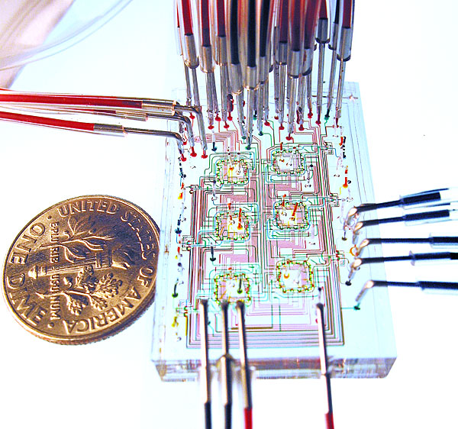
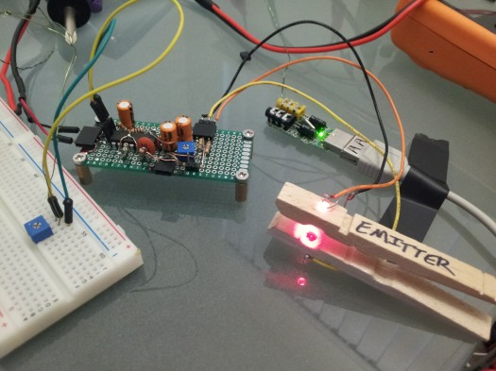
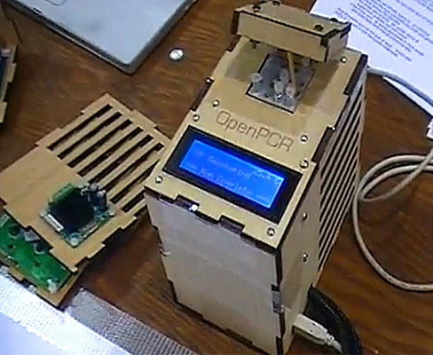
Real life application for Arduinos
MP3 player
Phone
Robots
Microfluidic devices
Open PCR
ECG and pulse
oximeter
http://www.nudatech.com/blog/20-arduino-projects-of-2012/
http://medicarduino.net/?cat=4

